Slide 1

Assignment 3 ASP.NET Web API Basic Authentication BDAT 1001 Information Encoding Standards Instructor – Nital Shah
Kenta Shirakura
200206054

Slide 2
Summary of the assignment
Why we need Authentication in Web API?
How Basic Authentication Work in Web API?
How to Implement Basic Authentication in ASP.NET Web API?
How to Enable Basic Authentication in Web API?
Testing the ASP.NET Web API Basic Authentication using Postman

Slide 3
Why we need Authentication in Web API?
It is an important security measure. Stateless Constraint is one of the Rest Constraints which requires the communication between servers and the client to be stateless.
In this method, the client information is not stored on the server, but rather the request from the client contains all the necessary information required by the server.

Slide 4
How Basic Authentication Work in Web API?
Generally the credential is included in the authorization header to allow authentication. So if the request does not contain the credential, the server will return 401 (Unauthorized) error. This response also includes the WWW-Authenticate header to indicate that the server supports Basic Authentication.
Usually the credential that is included in the request looks like name:password“ and is sent in base64-encoded format for encryption.
It is also noteworthy that ASP.NET Web API Basic Authentication uses “realm.” concept.

Slide 5
How to Implement Basic Authentication in ASP.NET Web API?
This is basically what we did in the visual studio, so I will explain the process over next few slides.

Slide 6
How to Enable Basic Authentication in Web API?
By applying the BasicAuthenticationAttribute, we can enable basic authentication in many different ways.
If we register the BasicAuthenticationAttribute using Register() method in WebApiConfig class, then we can enable the basic authentication across the entire API. If we want to enable the basic authentication in particular controllers, we can apply the BasicAuthenticationAttribute on a specific controller. We can also unable the basic authentication to the particular method.

Slide 7
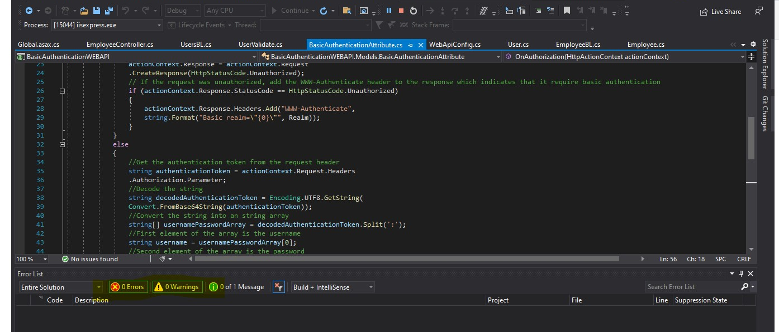
Screen shot of code runs

Slide 8
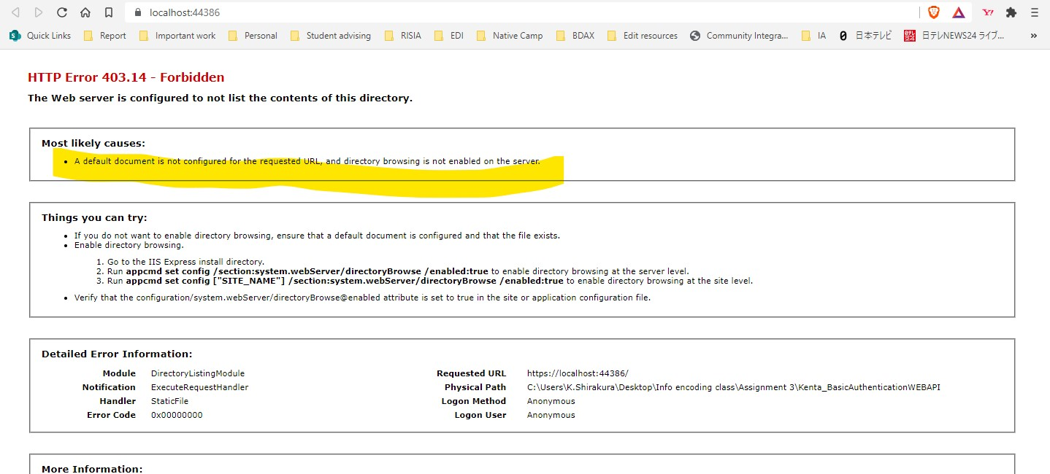
Screen shot of code runs

Slide 9
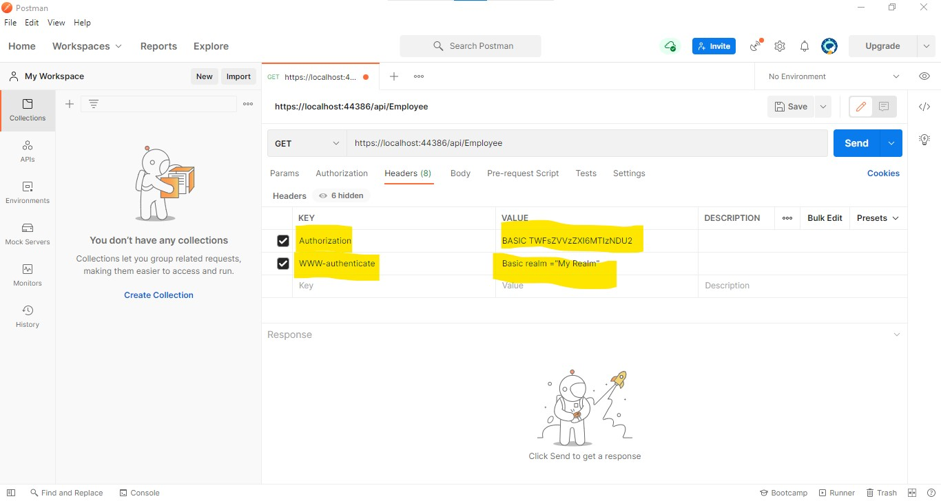
Screen shot of code runs

Slide 10
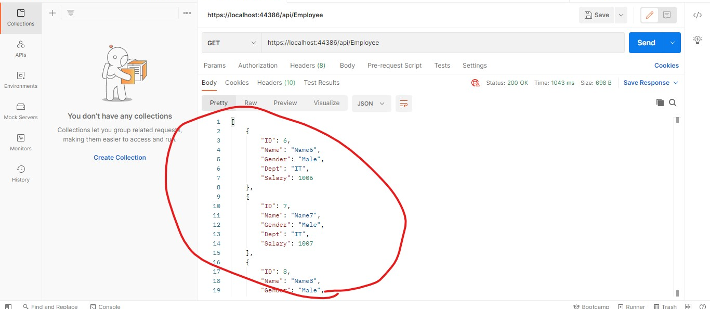
Screen shot of code runs

Slide 11
Thank you!

Slide 12
http://youtu.be/2KpNIxMAJt4?hd=1
Link to the video

